Slide 1


Slide 2
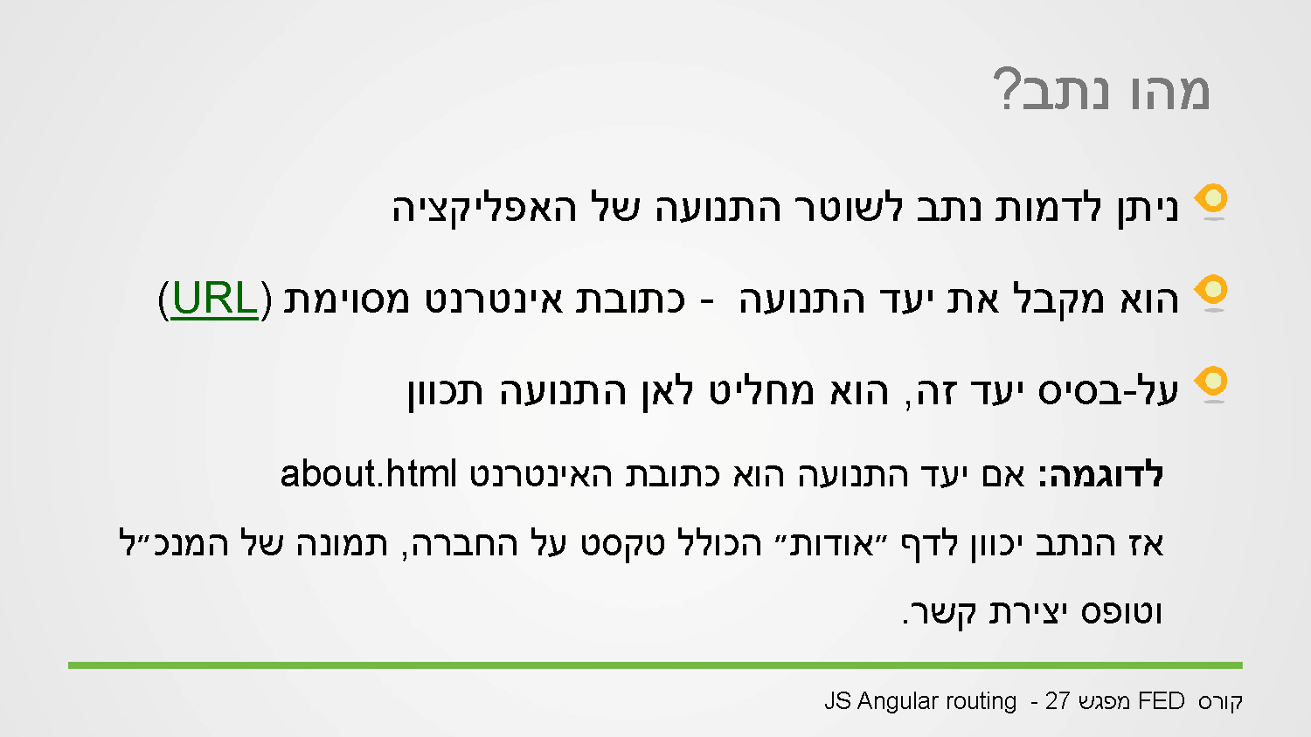
Notes:
The router listens on every route after the main URL lie www.nir.com/[listen text], we can configure what happens when the url (endpoint is the term for specific url), meaning in the router we have like a table for url endpoint X load files Y
Eg:
“/” home.html
homeCtrl
“/messages” messages.html
messages.ctrl
“/messages/[x] ->load-> messageDetails.html
messageDetailsCtrl
otherwise

Slide 3
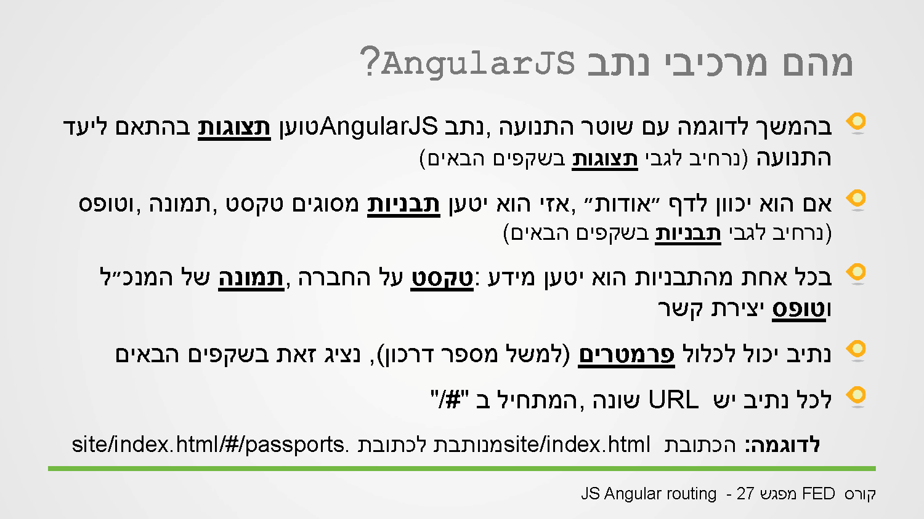

Slide 4
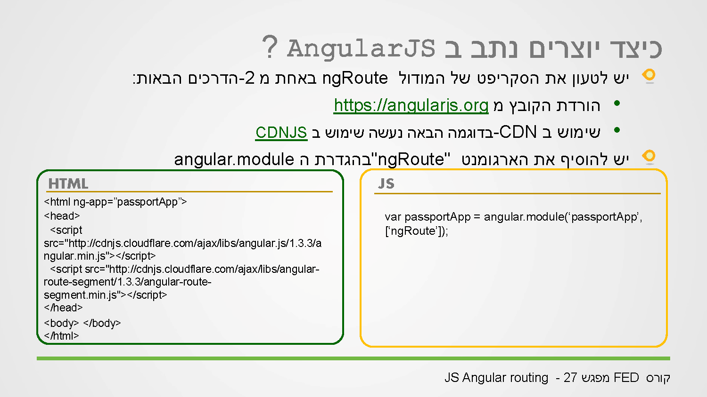
Notes:
To use routing we need a dependency on module ngRout, we need to add the dependency to the module line and either load the js file or insert a link in the html.

Slide 5
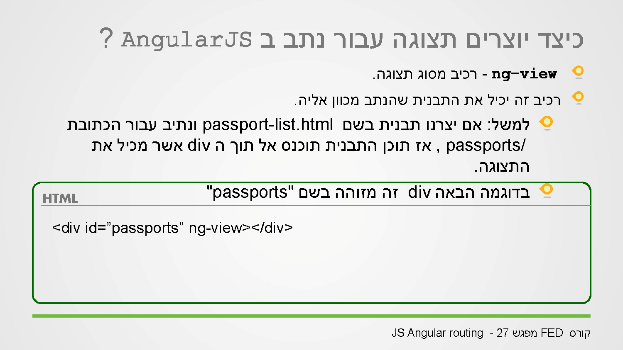
Notes:
The index.html will usually contain a single line that has ng-view
<div ng-view></div>
Or
<ng-view></ng-view>
Ng-view will be the place in the html where the replacing html will be inserted (that are defined in the route)
The index.html will contain only elements that will be constant in all pages like footers or navbars.

Slide 6
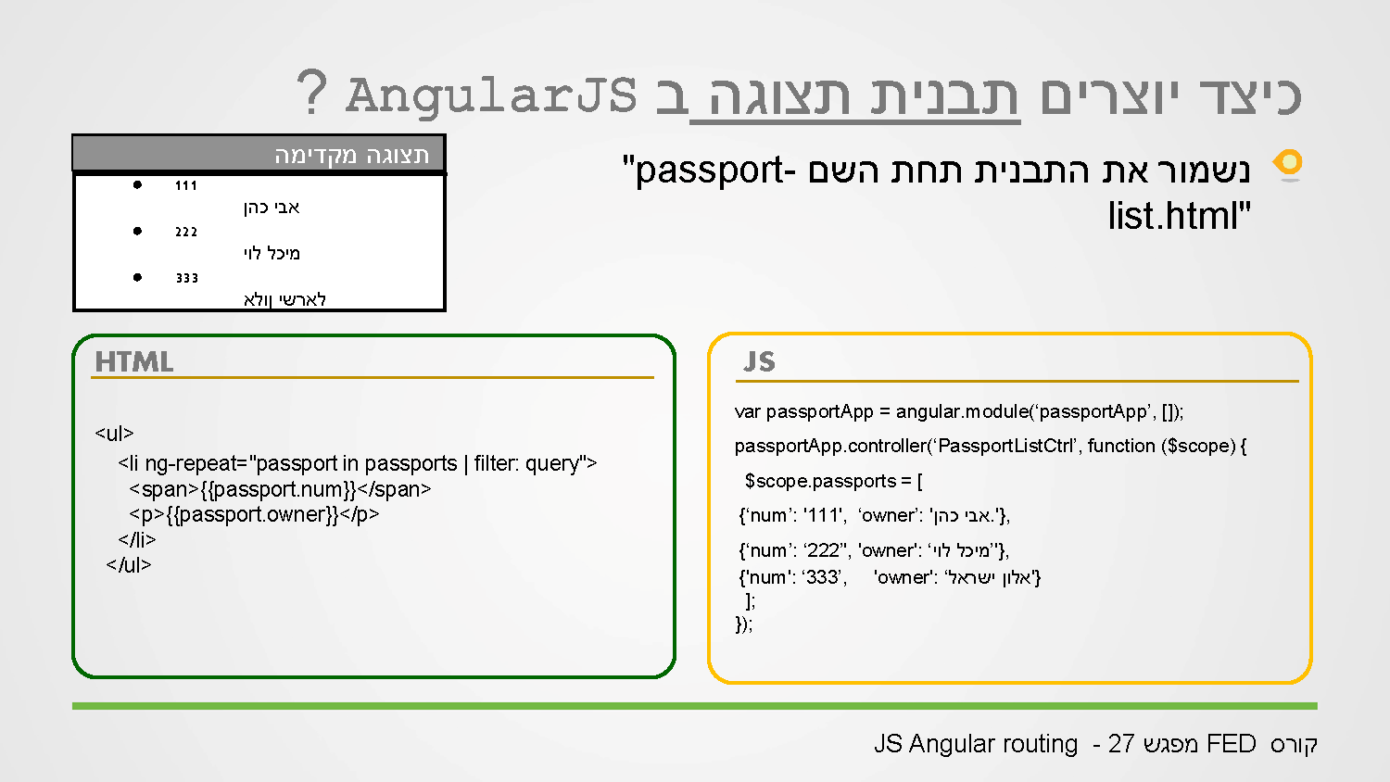

Slide 7
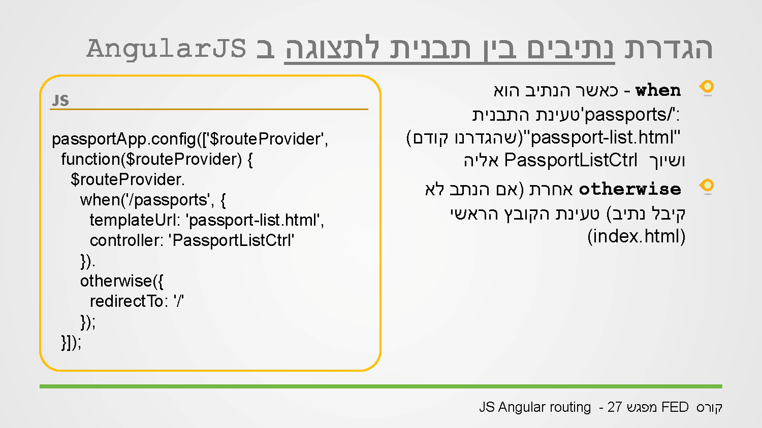
Notes:
We have to write the code what happens when the url is X
The route prodider has 2 functions when, otherwise.
When get 2 parameters – string of the url, object with keys (templateUrl : ‘string of the file .html’ , controller : ‘name of the controller file without file ext’
the syctax is:
App.config(function($routeProvider){
$routeProvider
.when(‘/’,{
templateUrl : ‘home.html’,
controller : ‘homeCtrl’
})
.when(‘/messages”,{
templateUrl: ‘messages.html’,
controller : ‘messagesCtrl’
})
});

Slide 8
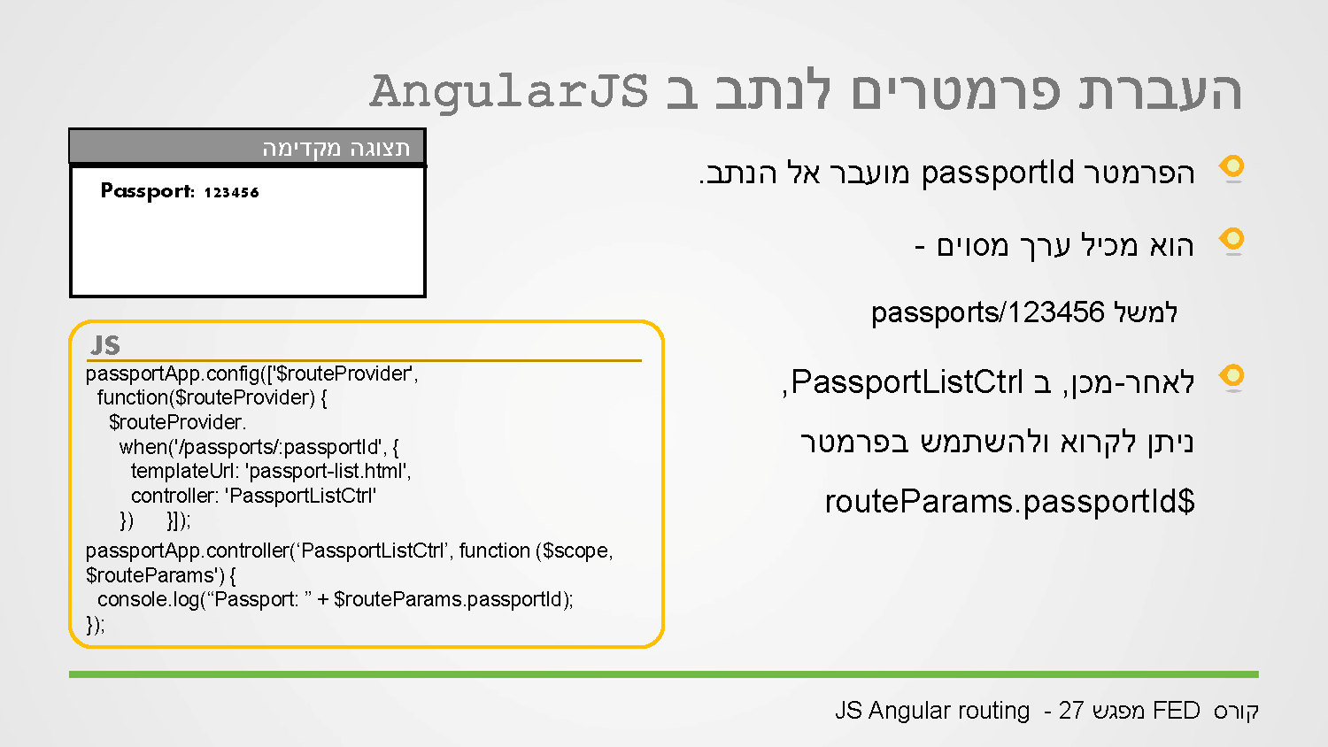

Slide 9
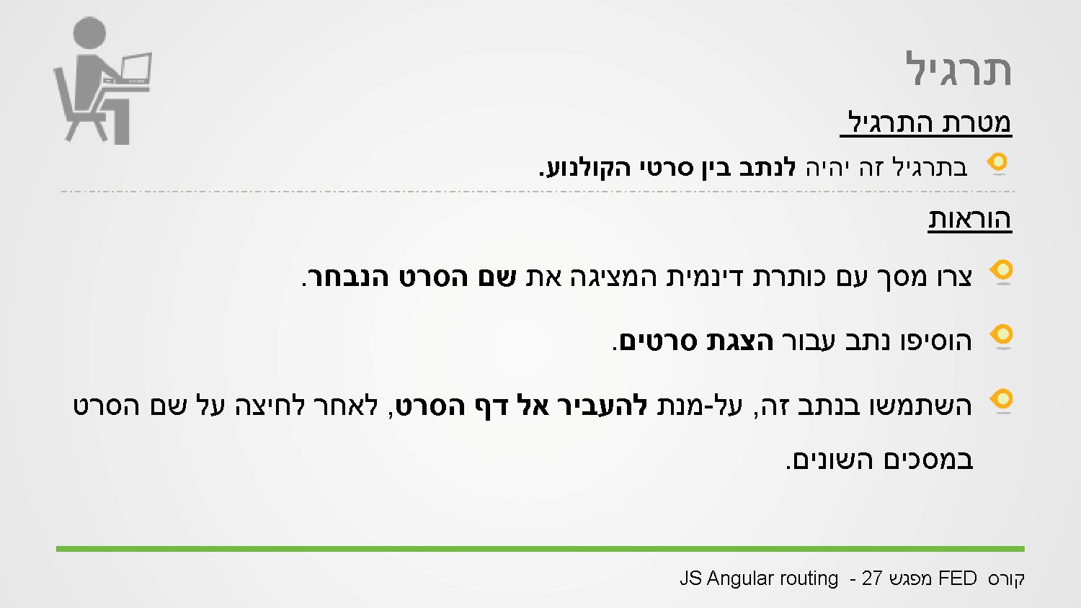

Slide 10
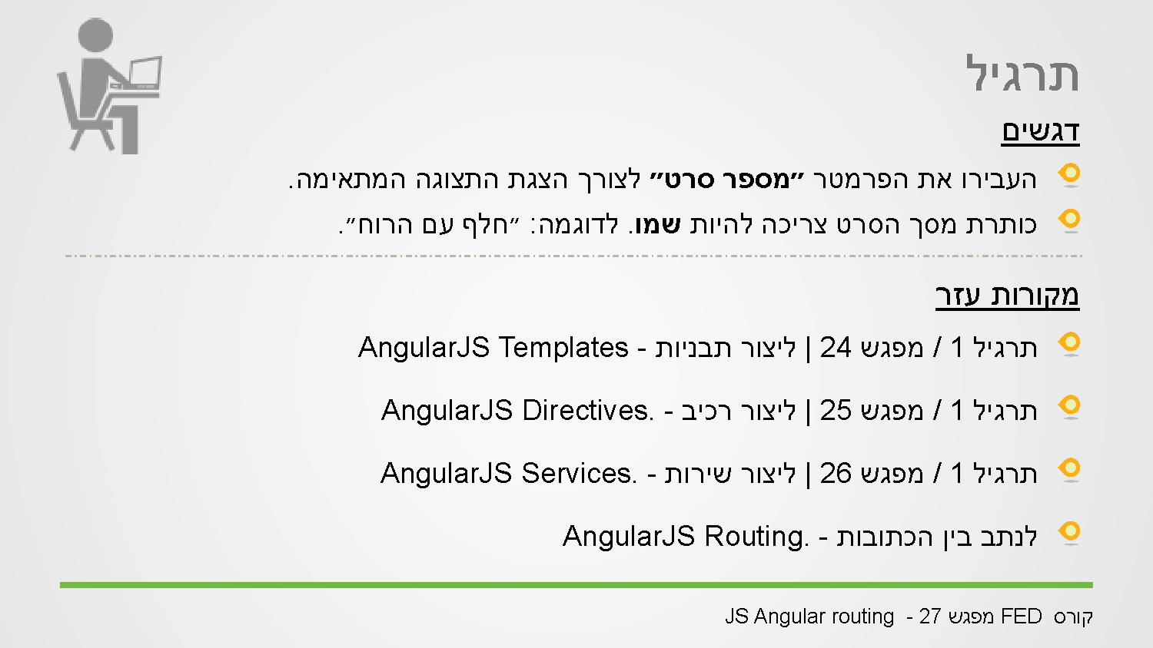

Slide 11
